Slide 1
Middle States Accreditation 2025

Slide 2
About the project
Do you know what helps you make your point clear?
Lists like this one:
They’re simple
You can organize your ideas clearly
You’ll never forget to buy milk!
And the most important thing: the audience won’t miss the point of your presentation

Slide 3
Introduction
Accreditation is a process of peer review that the educational community has adopted for its self-regulation since early in the 20th century. It is a voluntary process intended to strengthen and sustain the quality and integrity of higher education, making it worthy of public confidence. Institutions choose to apply for accredited status, and once accredited, they agree to abide by the standards of their accrediting organization and to regulate themselves by taking responsibility for their own improvement.

Slide 5
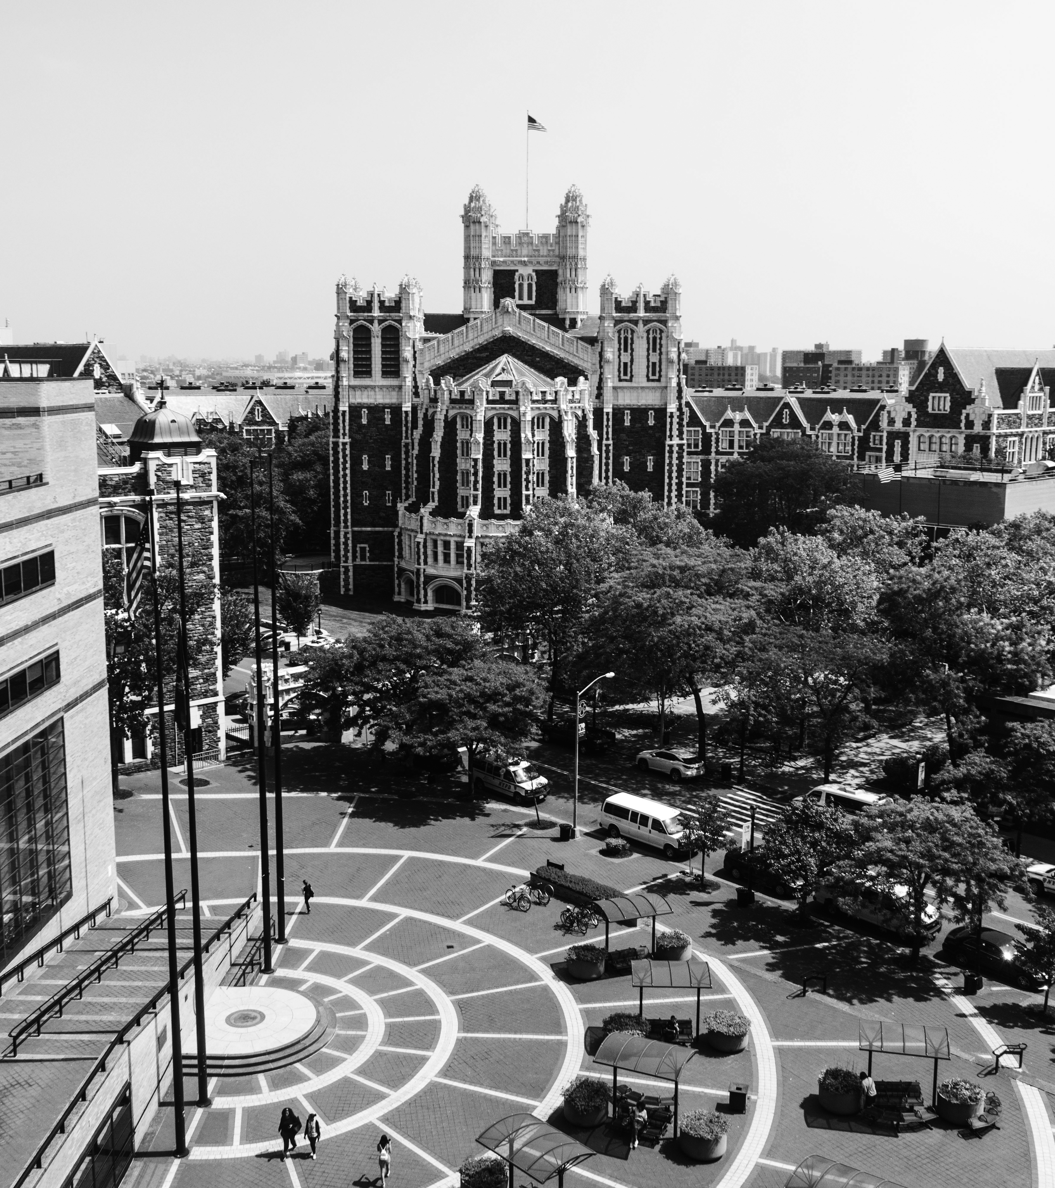
Inspirational words

Slide 6
123,456,789
Big numbers catch your audience’s attention

Slide 7
24h 37m 23s
333,000.00
386,000 km
Earths is the Sun’s mass
It’s Jupiter's rotation period
It’s the distance between Earth and the Moon

Slide 8
Status report
1
Schedule |  | The project schedule is on track
Resourcing |  | Resourcing is adequate
Budget |  | Project is within budget
Risks |  | All project risks are under control
Issues |  | Project issues need to be solved
Benefits |  | Project benefits do not meet the expectations
2
3
4
5
6

Slide 9
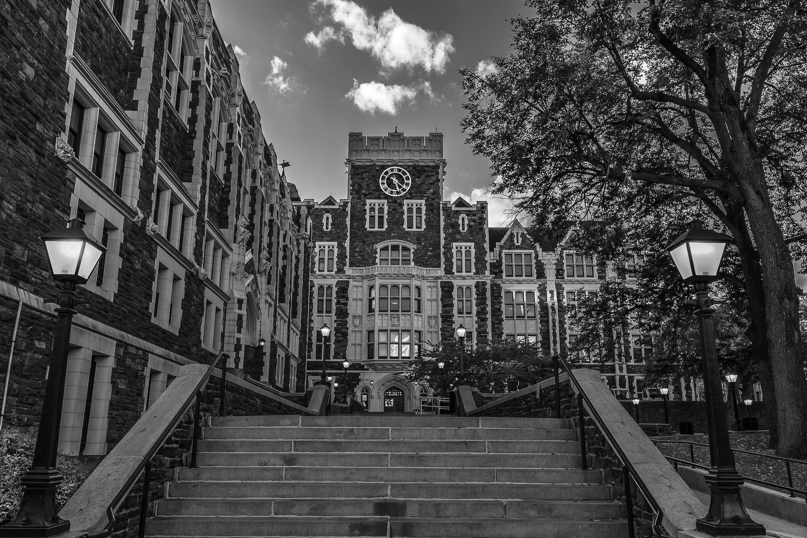
Summary video
You can replace the image on the screen with your own work. Just right-click on it and select “Replace image”

Slide 10
Location
New York City
Since 1847, The City College of New York has provided a high quality and affordable education to generations of New Yorkers in a wide variety of disciplines. CCNY embraces its role at the forefront of social change.
Located in the heart of New York City, CCNY is home to such important 'firsts' as: The first college explicitly founded on the ideal of educating the 'whole people', the first documentary film program in the U.S., the first intercollegiate lacrosse game played in the U.S., first student government in the nation, and the longest running Alumni Association in the U.S.

Slide 11
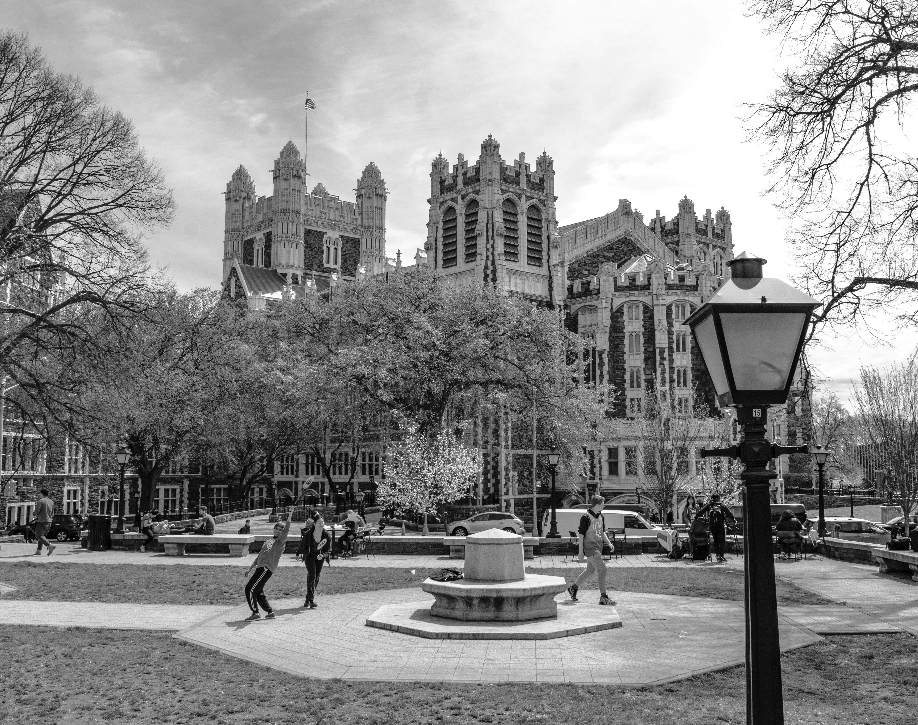
Conclusions
Here you could give a brief description of the topic you want to talk about. For example, if you want to talk about Mercury, you could say that it’s the smallest planet in the entire Solar System

Slide 12

THE COMMITTEE THANKS YOU
COMMITTEE MEMBERS
Jane Smith
212-650-0000 | jsmith@ccny.cuny.edu
Jane Smith
212-650-0000 | jsmith@ccny.cuny.edu
Jane Smith
212-650-0000 | jsmith@ccny.cuny.edu
Jane Smith
212-650-0000 | jsmith@ccny.cuny.edu
Jane Smith
212-650-0000 | jsmith@ccny.cuny.edu
Jane Smith
212-650-0000 | jsmith@ccny.cuny.edu

